Slide 1
Creating and Using Graphics

Slide 2
Why use graphics
Increases understanding
Clarifies meaning
Improves communication
Adds depth, detail, and data

Slide 3
Special considerations
Use source material ethically
  Check copyright
  Use only open source or software provided media
    Open source images can be found online
    Be sure to check the license on the image before use
    Not all images listed as open source are legally created
      Photos of a private residence
      Photos of a copyrighted work
      Exact reproductions of a copyrighted work

Slide 4
Consider all audiences
Accessible design
  In order to be accessible to everyone, images must also have text-based descriptions called alt text
    Alternate text for individuals using a screen reader
    This text should accurately describe the image
    Alt text can be added to images in any document, presentation, or website
    For Microsoft products, right click the image and click “alt text”
    All the images in this presentation have alt text – check it out!
  In order to be accessible to everyone, videos with oral components must have captions or a written document
    Hosting programs like YouTube will add captions for you
    Presentation software like PowerPoint can display captions as you speak
    For other videos, write a script before recording

Slide 5
Utilizing graphics
Visuals must increase reader understanding
  Do not use visual elements as filler or fluff
Visuals must present information clearly
Visuals must be appropriate
  Age
  Context
  Culture

Slide 6
Types of graphics
Tables
Graphs
Charts
Diagrams
Photographs
Illustrations
Videos
Icons
Symbols
Infographics

Slide 7
Tables
Begin with a title
Consists of several cells
Data is contained in columns (vertical) and rows (horizontal)
The cell where a column and row meet contains information for those two elements combined
Contain clear and reader-centered column and row headers
  The left-hand header is sometimes called a “stub”
Be sure that all your data is comparable (the same type of data)
These can be easily created in Excel or PowerPoint
Example: grading rubric!

Slide 8
Table Example
The header is the letter grade
The stub is the category being graded
In order to see how to make an “A” in the category of “Graphic,” look at the cell where the “A” column meets the “Graphic” row
 | A | B | C | D | F
Clarity | No clarity issues | Minor clarity issues | Some clarity issues | Several clarity issues | Unclear for large sections
Completeness | No missing or unclear steps | One unclear or missing step | Two unclear or missing steps | Three unclear or missing steps | Four or more unclear or missing steps
Formatting | Formatting is logical and seamless | There is one formatting issue that can be easily fixed | There are two – three formatting issue that can be easily fixed | There are four or more formatting issue that can be easily fixed | There is one formatting issue that can be easily fixed or a major formatting issue
Graphics | Graphics are well planned and implemented | Graphics are well planned and have only minor implementation issues | Graphics are well planned but have major implementation issues | Graphics are not well planned and implemented | Graphics are missing or unintelligible

Slide 9
Graphs
Visual representations of numbers
Uses colors and patterns to show comparison
Often created using Microsoft or Google tools such as Word, Docs, PowerPoint, and Excel
Uses a horizontal and vertical axis
  One axis is the categories being compared
  The other axis is the measurement
  Uses bars, columns, or lines to map data
    Bar graphs use horizontal bars
      Horizontal axis measures
      Vertical axis notes the categories
    Column graphs are the opposite of bar graphs
    Line graphs mark single points connected with a line to show progress

Slide 10
Graph examples

Slide 11
Charts
Displays relationships
Uses shapes, colors, and patterns to convey meaning
Often created using Microsoft or Google tools such as Word, Docs, PowerPoint, and Excel
Common types include
  Pie
  Organization
  Diagram
  Flow
  Logic tree

Slide 12
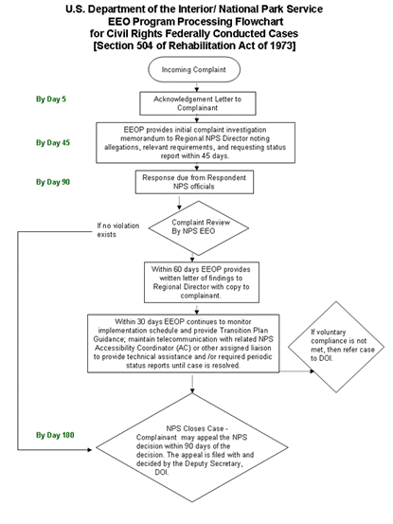
Flowchart example
U.S. Department of the Interior/National Park Service. EEO Section 504 Flowchart.
[Digital image]. (2020, July 23). Retrieved from https://www.nps.gov/aboutus/eeotechguidance.htm

Slide 13
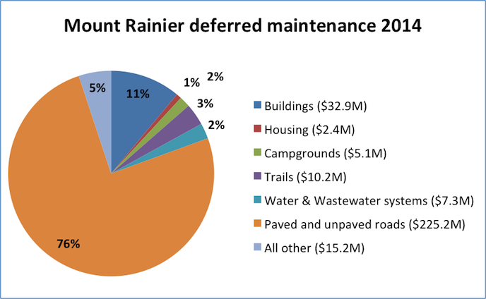
Pie chart example
U.S. Department of the Interior/National Park Service. “Mount Rainier Deferred Maintenance.” [Digital image]. Mount Rainier Deferred Maintenance Backlogs Identified - Part of $11.49 billion backlog across the National Park System (2015, March 26). Retrieved from https://www.nps.gov/mora/learn/news/maintenance-backlog-2014.htm

Slide 14
Photographs and Illustrations
Are static images of an object, place, or thing
Often cropped or limited in order to highlight a specific element
Can be in color or in black and white
Photos can sometimes contain details beyond the scope of the document
Illustrations can omit unnecessary details to help readers focus on the necessary details
Screenshots, pictures the computer can take of the exact screen display at any given moment, are useful substitutes for photographs when discussing digital tools and content
  Screenshots should always be carefully cropped to focus on only what is necessary

Slide 15

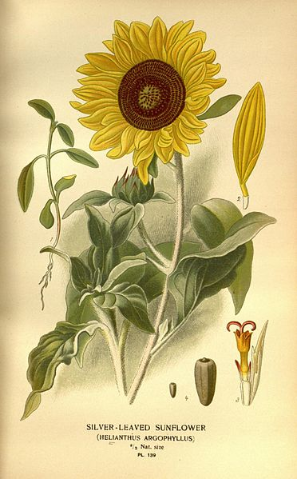
Photograph and illustration example
Public Domain, https://commons.wikimedia.org/w/index.php?curid=429137
By Bois, D.; Frederick Warne (Firm); Herincq, B.; Step, Edward; Watson, William - https://www.flickr.com/photos/biodivlibrary/10574954564, Public Domain, https://commons.wikimedia.org/w/index.php?curid=42688015

Slide 16
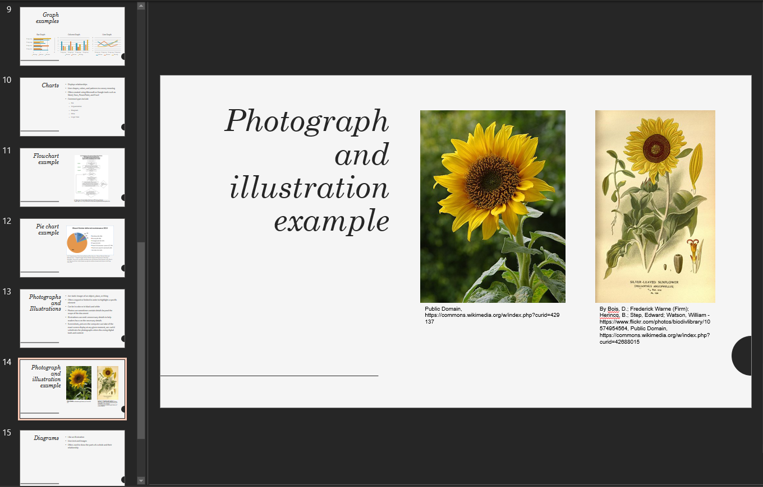
Screenshot example

Slide 17
Diagrams
Like an illustration
Uses text and images
Often used to show the parts of a whole and their relationship

Slide 18
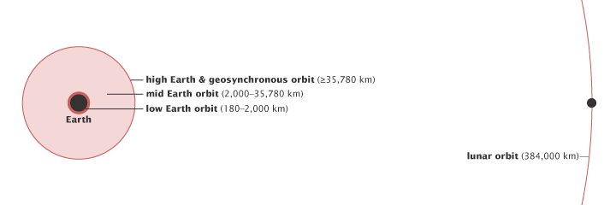
Diagram example
Simmon, Robert. “Diagram of different classes of orbital altitudes.” Catalog of Earth Satellite Orbits. NASA (September 4, 2009). Retrieved from: https://earthobservatory.nasa.gov/features/OrbitsCatalog

Slide 19
Sources
Fowler, Susan L., and Victor R. Stanwick. Web Application Design Handbook : Best Practices for Web-Based Software. Morgan Kaufmann, 2004. EBSCOhost, search.ebscohost.com/login.aspx?direct=true&db=nlebk&AN=114196&site=ehost-live&scope=site.
“Image Description Guidelines.” DIAGRAM Center, 16 Sept. 2015, diagramcenter.org/table-of-contents-2.html.

